Slide 1
Introduction to C# Windows Forms Applications
Windows Forms is a Graphical User Interface(GUI) class library which is bundled in .Net Framework. Its main purpose is to provide an easier interface to develop the applications for desktop, tablet, PCs. It is also termed as the WinForms.
he applications which are developed by using Windows Forms or WinForms are known as the Windows Forms Applications that runs on the desktop computer. WinForms can be used only to develop the Windows Forms Applications not web applications. WinForms applications can contain the different type of controls like labels, list boxes, tooltip etc.
Creating a Windows Forms Application Using Visual Studio
First, open the Visual Studio then Go to File -> New -> Project to create a new project and then select the language as Visual C# from the left menu. Click on Windows Forms App(.NET Framework) in the middle of current window. After that give the project name and Click OK.

Slide 2
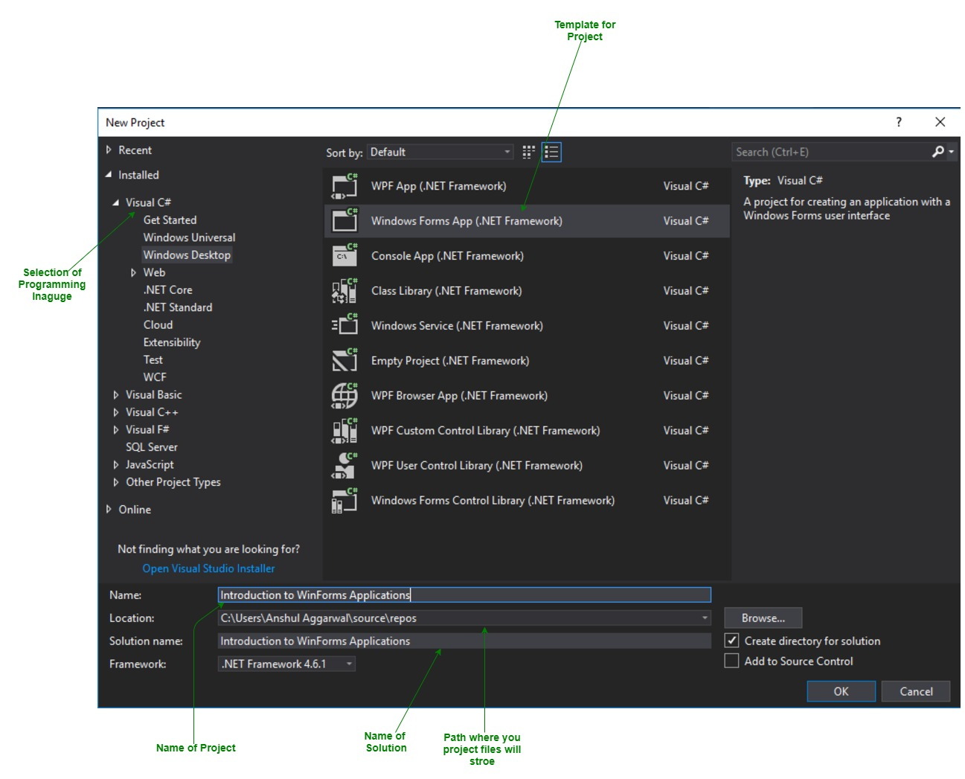

Slide 3
After that following window will display which will be divided into three parts as follows:
Editor Window or Main Window: Here, you will work with forms and code editing. You can notice the layout of form which is now blank. You will double click the form then it will open the code for that.
Solution Explorer Window: It is used to navigate between all items in solution. For example, if you will select a file form this window then particular information will be display in the property window.
Properties Window: This window is used to change the different properties of the selected item in the Solution Explorer. Also, you can change the properties of components or controls that you will add to the forms.
Now to add the controls to your WinForms application go to Toolbox tab present in the extreme left side of Visual Studio. Here, you can see a list of controls. To access the most commonly used controls go to Common Controls present in Toolbox tab.

Slide 4
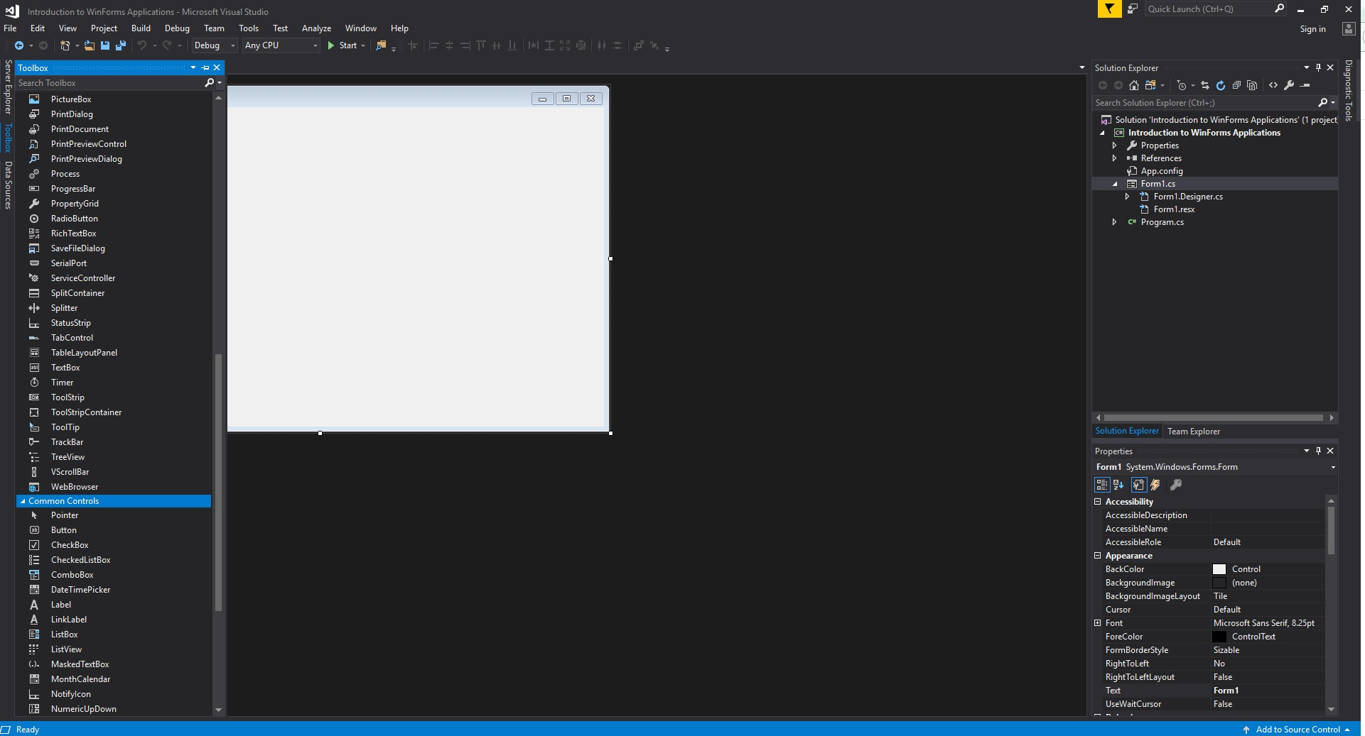
Now drag and drop the controls that you needed on created Form. For example, if you can add TextBox, ListBox, Button etc. as shown below. By clicking on the particular dropped control you can see and change its properties present in the right most corner of Visual Studio.

Slide 5
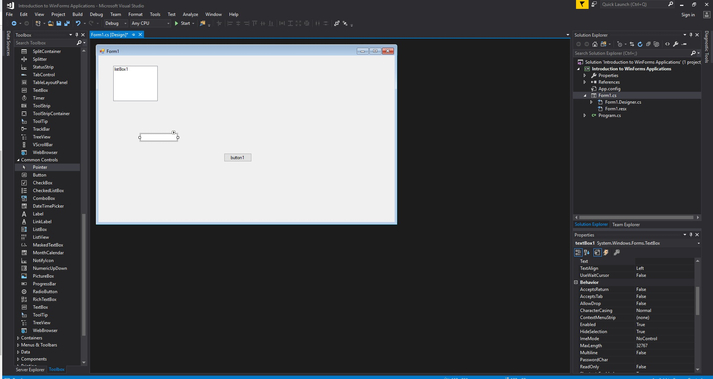
In the above image, you can see the TextBox is selected and its properties like TextAlign, MaxLength etc. are opened in right most corner. You can change its properties’ values as per the application need. The code of controls will be automatically added in the background. You can check the Form1.Designer.cs file present in the Solution Explorer Window.

Slide 6
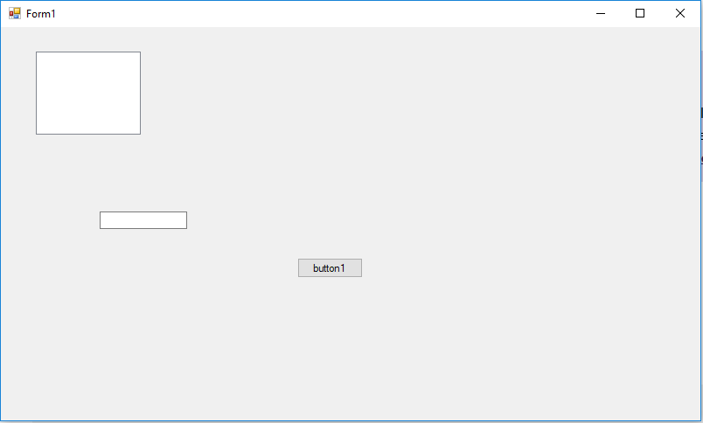
To run the program you can use an F5 key or Play button present in the toolbar of Visual Studio. To stop the program you can use pause button present in the ToolBar. You can also run the program by going to Debug->Start Debugging menu in the menubar.

Slide 7
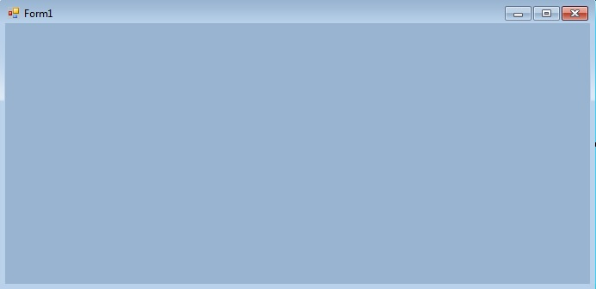
Button in C#
A Button is an essential part of an application, or software, or webpage. It allows the user to interact with the application or software. For example, if a user wants to exit from the current application so, he/she click the exit button which closes the application. It can be used to perform many actions like to submit, upload, download, etc. according to the requirement of your program. It can be available with different shape, size, color, etc. and you can reuse them in different applications. In .NET Framework, Button class is used to represent windows button control and it is inherited from ButtonBase class. It is defined under System.Windows.Forms namespace.
In C# you can create a button on the windows form by using two different ways:
Design-Time: It is the easiest method to create a button. Use the below steps:
Step 1: Create a windows form as shown in the below image: Visual Studio -> File -> New -> Project -> WindowsFormApp

Slide 8
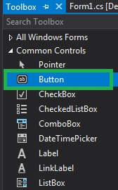
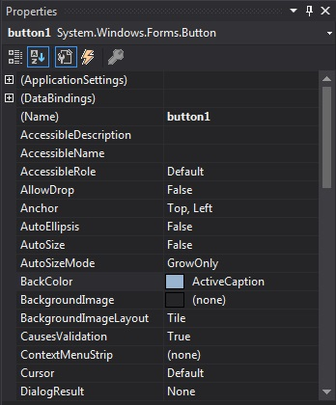
Step 2: Drag the Button control from the ToolBox and drop it on the windows form. You are allowed to place a Button control anywhere on the windows form according to your need.
Step 3: After drag and drop you will go to the properties of the Button control to set the properties of the Button.

Slide 9
2. Run-Time: It is a little bit trickier than the above method. In this method, you can create your own Button using the Button class.
Step 1: Create a button using the Button() constructor is provided by the Button class.
// Creating Button using Button class
Button MyButton = new Button();
Step 2: After creating Button, set the properties of the Button provided by the Button class.
// Set the location of the button
Mybutton.Location = new Point(225, 198);
// Set text inside the button
Mybutton.Text = "Submit";
// Set the AutoSize property of the button
Mybutton.AutoSize = true;

Slide 10
// Set the background color of the button
Mybutton.BackColor = Color.LightBlue;
// Set the padding of the button
Mybutton.Padding = new Padding(6);
// Set font of the text present in the button
Mybutton.Font = new Font("French Script MT", 18);
Step 3: And last add this button control to form using Add() method.
// Add this Button to form
this.Controls.Add(Mybutton);

Slide 11
namespace WindowsFormsApp8 {
public partial class Form1 : Form {
public Form1()
{
InitializeComponent();
}
private void Form1_Load(object sender, EventArgs e)
{
// Creating and setting the properties of label
Label l = new Label();
l.AutoSize = true;
l.Text = "Do you want to submit this project?";
l.Location = new Point(222, 145);
l.Font = new Font("French Script MT", 18);
// Adding this label to form
this.Controls.Add(l);
// Creating and setting the properties of Button
Button Mybutton = new Button();
Mybutton.Location = new Point(225, 198);
Mybutton.Text = "Submit";
Mybutton.AutoSize = true;
Mybutton.BackColor = Color.LightBlue;
Mybutton.Padding = new Padding(6);
Mybutton.Font = new Font("French Script MT", 18);
// Adding this button to form
this.Controls.Add(Mybutton);
// Creating and setting the properties of Button
Button Mybutton1 = new Button();
Mybutton1.Location = new Point(360, 198);
Mybutton1.Text = "Cancel";
Mybutton1.AutoSize = true;
Mybutton1.BackColor = Color.LightPink;
Mybutton1.Padding = new Padding(6);
Mybutton1.Font = new Font("French Script MT", 18);
// Adding this button to form
this.Controls.Add(Mybutton1);
}
}
}

Slide 12
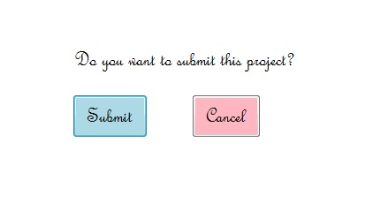

Slide 13
Important Properties of Button
Property | Description
BackColor | Using BackColor property you can set the background color of the button.
BackgroundImage | Using BackgroundImage property you can set the background image on the button.
AutoEllipsis | Using AutoEllipsis property you can set a value which shows that whether the ellipsis character (…) appears at the right edge of the control which denotes that the button text extends beyond the specified length of the button.
AutoSize | Using AutoSize property you can set a value which shows whether the button resizes based on its contents.
Enabled | Using Enabled property you can set a value which shows whether the button can respond to user interaction.
Events | Using Events property you can get the list of the event handlers that are applied on the given button.
Font | Using Font property you can set the font of the button.
FontHeight | Using FontHeight property you can set the height of the font.
ForeColor | Using ForeColor property you can set the foreground color of the button.
Height | Using Height property you can set the height of the button.
Image | Using Image property you can set the image on the button.
Margin | Using Margin property you can set the margin between controls.
Name | Using Name property you can set the name of the button.
Padding | Using Padding property you can set the padding within the button.
Visible | Using Visible property you can set a value which shows whether the button and all its child buttons are displayed.

Slide 14
Important Events on Button
Event | Description
Click | This event occur when the button is clicked.
DoubleClick | This event occur when the user performs double click on the button.
Enter | This event occur when the control is entered.
KeyPress | This event occur when the character, or space, or backspace key is pressed while the control has focus.
Leave | This event occur when the input focus leaves the control.
MouseClick | This event occur when you click the mouse pointer on the button.
MouseDoubleClick | This event occur when you double click the mouse pointer on the button.
MouseHover | This event occur when the mouse pointer placed on the button.
MouseLeave | This event occur when the mouse pointer leaves the button.

Slide 15
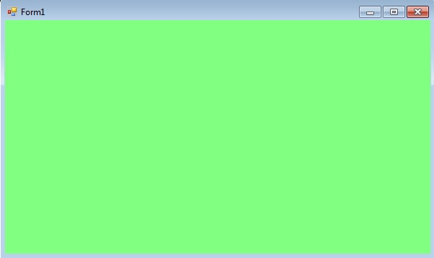
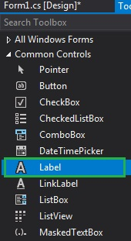
Label in C#
Label control is used to display text on the form and it does not take part in user input or in mouse or keyboard events. The Label is a class and it is defined under System.Windows.Forms namespace. In windows form, you can create Label in two different ways: 1. Design-Time: It is the easiest method to create a Label control using the following steps:
Step 1: Create a windows form as shown in the below image: Visual Studio -> File -> New -> Project -> WindowsFormApp
Step 2: Drag the Label control from the ToolBox and drop it on the windows form. You are allowed to place a Label control anywhere on the windows form according to your need.

Slide 16
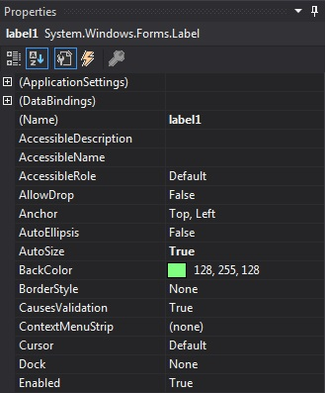
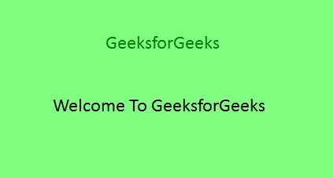
Step 3: After drag and drop you will go to the properties of the Label control to set the properties of the Label according to your need.
2. Run-Time: It is a little bit trickier than the above method. In this method, you can set create your own Label control using the Label class. Steps to create a dynamic label:
Step 1: Create a label using the Label() constructor is provided by the Label class.
// Creating label using Label class
Label mylab = new Label();

Slide 17
using System;
using System.Windows.Forms;
namespace WindowsFormsApp18 {
public partial class Form1 : Form {
public Form1()
{
InitializeComponent();
}
private void Form1_Load(object sender, EventArgs e)
{
// Creating and setting the label
Label mylab = new Label();
mylab.Text = "GeeksforGeeks";
mylab.Location = new Point(222, 90);
mylab.AutoSize = true;
mylab.Font = new Font("Calibri", 18);
mylab.ForeColor = Color.Green;
mylab.Padding = new Padding(6);
// Adding this control to the form
this.Controls.Add(mylab);
}
}
}

Slide 18
Property | Description
AutoSize | This property is used to set a value indicating whether the Label control is automatically resized to display its entire contents.
BackColor | This property is used to set the background color for the Label control.
BackgroundImage | This property is used to set the background image for the Label control.
BorderStyle | This property is used to set the border style for the Label control.
FlatStyle | This property is used to set the flat style appearance of the label control.
Font | This property is used to set the font of the text displayed by the Label control.
FontHeight | This property is used to set the height of the font of the Label control.
ForeColor | This property is used to set the foreground color of the Label control.
Height | This property is used to set the height of the Label control.
Image | This property is used to set the image that is displayed on a Label.
Location | This property is used to set the coordinates of the upper-left corner of the Label control relative to the upper-left corner of its form.
Name | This property is used to set the name of the Label control.
Padding | This property is used to set padding within the Label control.
Size | This property is used to set the height and width of the Label control.
Text | This property is used to set the text associated with this Label control.
TextAlign | This property is used to set the alignment of text in the label.
Visible | This property is used to set a value indicating whether the control and all its child controls are displayed.
Width | This property is used to set the width of the Label control.

Slide 19
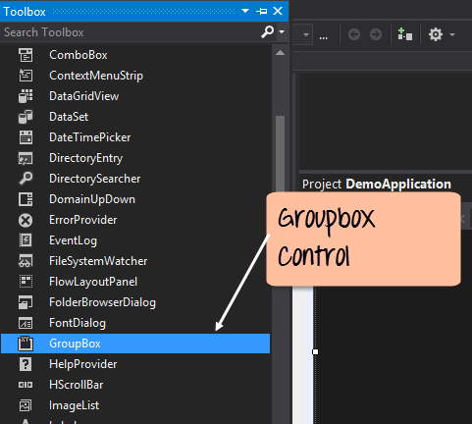
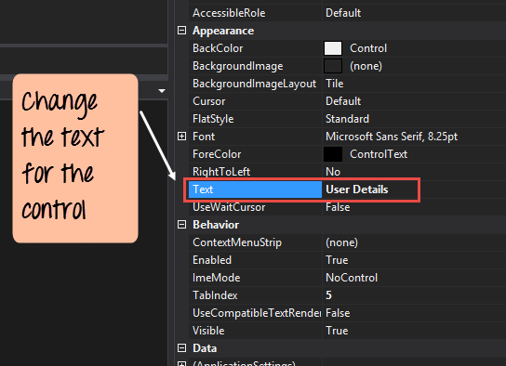
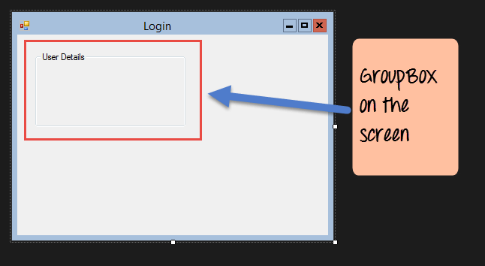
Group Box
A group box is used for logical grouping controls into a section. Let’s take an example if you had a collection of controls for entering details such as name and address of a person. Ideally, these are details of a person, so you would want to have these details in a separate section on the Form. For this purpose, you can have a group box.
Step 1) The first step is to drag the Groupbox control onto the Windows Form from the toolbox as shown below
Step 2) Once the groupbox has been added, go to the properties window by clicking on the groupbox control. In the properties window, go to the Text property and change it to “User Details”.
Once you make the above changes, you will see the following output
Output:-

Slide 20
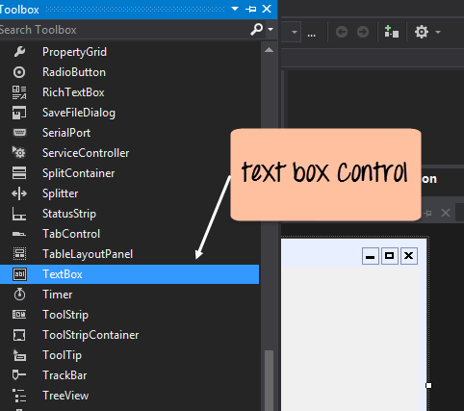
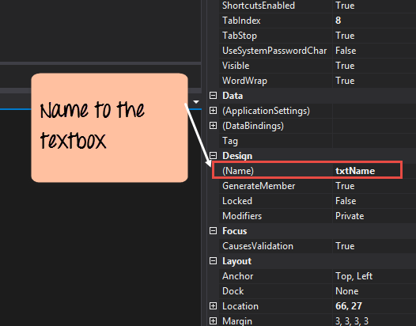
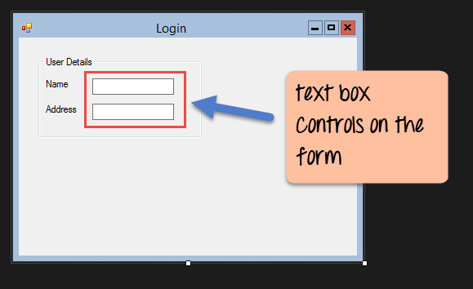
Textbox
A textbox is used for allowing a user to enter some text on the Windows application in C#. Let’s see how we can implement this with an example shown below. We will add 2 textboxes to the form, one for the Name and the other for the address to be entered for the user
Step 1) The first step is to drag the textbox control onto the Windows Form from the toolbox as shown below
Step 2) Once the text boxes have been added, go to the properties window by clicking on the textbox control. In the properties window, go to the Name property and add a meaningful name to each textbox. For example, name the textbox for the user as txtName and that for the address as txtAddress. A naming convention and standard should be made for controls because it becomes easier to add extra functionality to these controls.

Slide 21
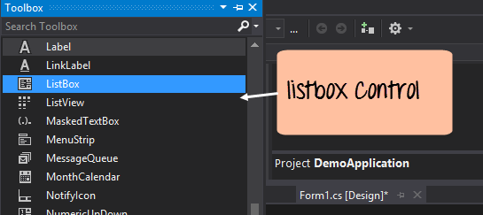
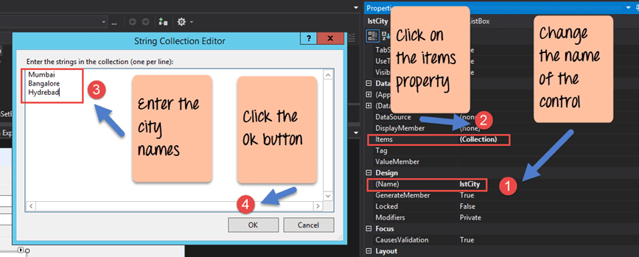
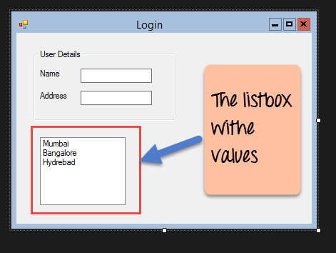
List box
A Listbox is used to showcase a list of items on the Windows form.
Step 1) The first step is to drag the list box control onto the Windows Form from the toolbox as shown below
Step 2) Once the list box has been added, go to the properties window by clicking on the list box control.
First, change the property of the Listbox box control, in our case, we have changed this to lstCity
Click on the Items property. This will allow you to add different items which can show up in the list box. In our case, we have selected items “collection”.
In the String Collection Editor, which pops up, enter the city names. In our case, we have entered “Mumbai”, “Bangalore” and “Hyderabad”.
Finally, click on the ‘OK’ button.
Once you make the above changes, you will see the following output

Slide 22
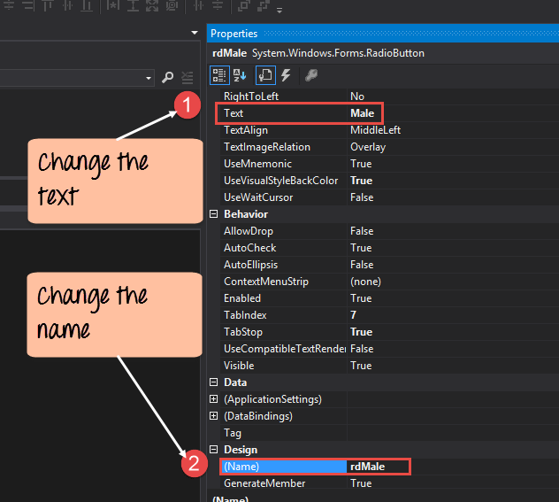
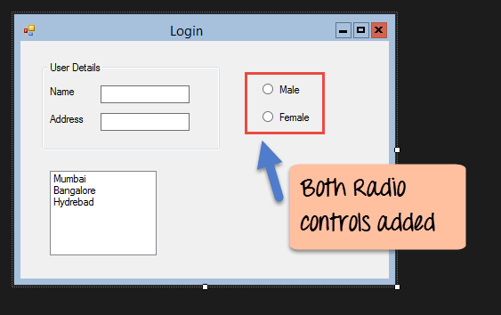
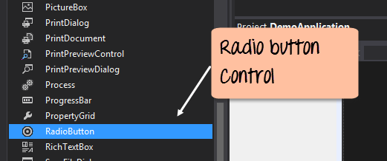
RadioButton
A Radiobutton is used to showcase a list of items out of which the user can choose one.
Step 1) The first step is to drag the ‘radiobutton’ control onto the Windows Form from the toolbox as shown below.
Step 2) Once the Radiobutton has been added, go to the properties window by clicking on the Radiobutton control.
First, you need to change the text property of both Radio controls. Go the properties windows and change the text to a male of one radiobutton and the text of the other to female.
Similarly, change the name property of both Radio controls. Go the properties windows and change the name to ‘rdMale’ of one radiobutton and to ‘rdfemale’ for the other one.

Slide 23
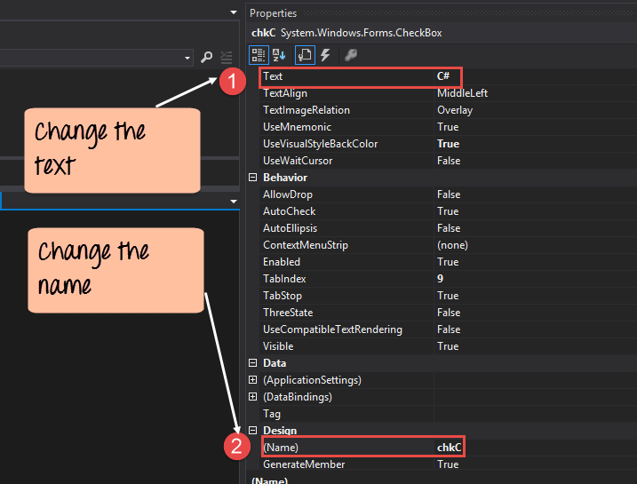
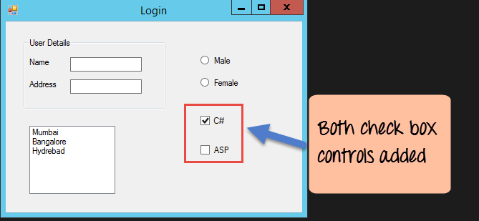
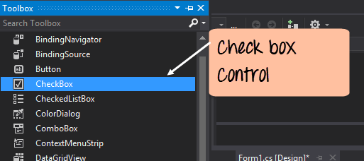
Checkbox
A checkbox is used to provide a list of options in which the user can choose multiple choices.We will add 2 checkboxes to our Windows forms. These checkboxes will provide an option to the user on whether they want to learn C# or ASP.Net.
Step 1) The first step is to drag the checkbox control onto the Windows Form from the toolbox as shown below.
Step 2) Once the checkbox has been added, go to the properties window by clicking on the Checkbox control.
In the properties window,
First, you need to change the text property of both checkbox controls. Go the properties windows and change the text to C# and ASP.Net.
Similarly, change the name property of both Radio controls. Go the properties windows and change the name to chkC of one checkbox and to chkASP for the other one

Slide 24
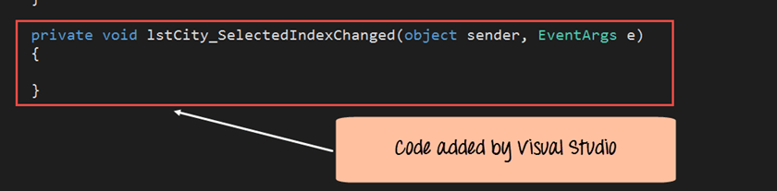
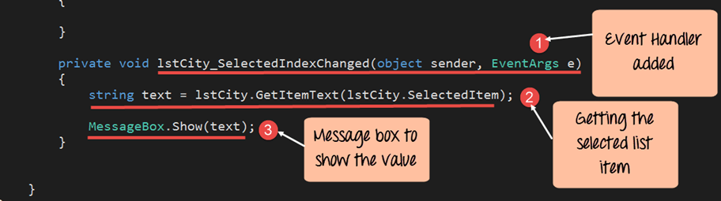
C# Event Handling for Controls
When working with windows form, you can add events to controls. An event is something that happens when an action is performed.Probably the most common action is the clicking of a button on a form.
In C# Windows Forms, you can add code which can be used to perform certain actions when a button is pressed on the form.
Normally when a button is pressed on a form, it means that some processing should take place.
Let’s take a look at one of the event and how it can be handled before we go to the button event scenario.
The below example will showcase an event for the Listbox control. So whenever an item is selected in the listbox control, a message box should pop up which shows the item selected. Let’s perform the following steps to achieve this.
Step 1) Double click on the Listbox in the form designer. By doing this, Visual Studio will automatically open up the code file for the form. And it will automatically add an event method to the code. This event method will be triggered, whenever any item in the listbox is selected.
Above is the snippet of code which is automatically added by Visual Studio, when you double-click the List box control on the form. Now let’s add the below section of code to this snippet of code, to add the required functionality to the listbox event.

Slide 25
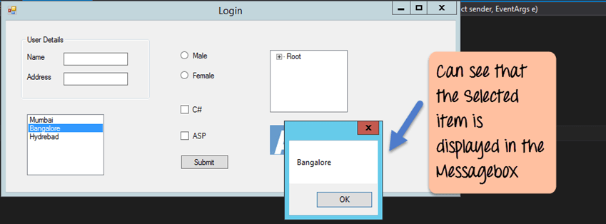
This is the event handler method which is automatically created by Visual Studio when you double-click the List box control. You don’t need to worry about the complexity of the method name or the parameters passed to the method.
Here we are getting the SelectedItem through the lstCity.SelectedItem property. Remember that lstCity is the name of our Listbox control. We then use the GetItemText method to get the actual value of the selected item. We then assign this value to the text variable.
Finally, we use the MessageBox method to display the text variable value to the user.
double click the button in the Forms Designer and it will automatically add the method for the button event handler. Then you just need to add the below code.

Slide 26
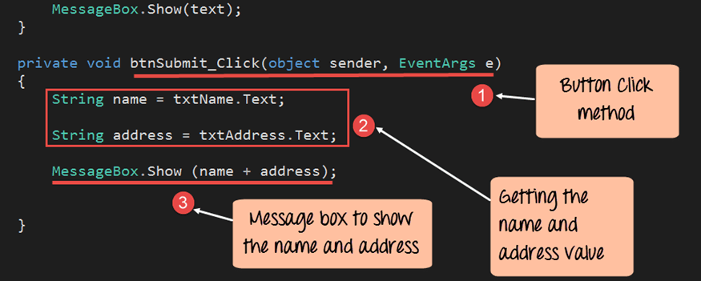
This is the event handler method which is automatically created by Visual Studio when you double click the button control. You don’t need to worry on the complexity of the method name or the parameters passed to the method.
Here we are getting values entered in the name and address textbox. The values can be taken from the text property of the textbox. We then assign the values to 2 variables, name, and address accordingly.
Finally, we use the MessageBox method to display the name and address values to the user.

Slide 27
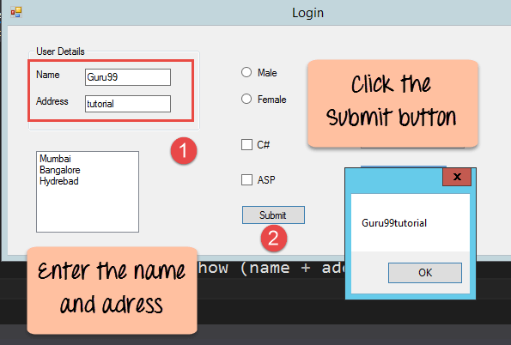
1)First, enter a value in the name and address field.
2)Then click on the Submit button
Once you click the Submit button, a message box will pop, and it will correctly show you what you entered in the user details section.

Slide 28
DataGridView Control In C#
The DataGridView control provides a powerful and flexible way to display data in a tabular format. You can use the DataGridView control to show read-only views of a small amount of data, or you can scale it to show editable views of very large sets of data. This control also let's you display data in a master-details view.
Data can be displayed in a tabular manner with sorting, paging, and editing options using the C# data presentation control GridView. The namespace Web.UI.WebControls is frequently used in web applications. GridView can be bound to various data sources like databases, XML, and other data sources.
Features of GridView in C#:
GridView in C# has several features that make it a popular choice for displaying data in web applications. Some of the key features of GridView are:
Sorting:
GridView allows the sorting of data in ascending or descending order. By pressing and holding down the shift key while clicking on the column headers, you can sort across several columns.
Paging:
GridView supports the paging of data, which allows you to display a subset of data at a time. This helps to increase the application's performance when dealing with large amounts of data.
Editing:
GridView provides editing capabilities, which allow users to edit the data directly in control. This feature is useful when the user needs to make changes to the data displayed in the control.
Selection:
GridView allows the selection of data rows, which can be utilized to perform various tasks on the selected rows, like deletion, updating, or exporting.
Formatting:
GridView provides formatting options for data displayed in the control. You can manipulate the font, size, color, and other formatting options for the data.

Slide 29
Properties of GridView in C#:
GridView in C# has several properties that can be used to customize its appearance and behavior. Some of the key properties of GridView are:
AutoGenerateColumns:
This property allows you to automatically generate columns based on the data source.
AllowSorting:
This property allows you to enable or disable data sorting in the GridView.
AllowPaging:
This property allows you to enable or disable the paging of data in the GridView.
ShowHeader:
This property allows you to show or hide the header of the GridView.
ShowFooter:
This property allows you to show or hide the footer of the GridView.
EditIndex:
This property allows you to set the index of the row being edited in the GridView.
Using GridView in C#:
Using GridView in C# is easy and straightforward. The first thing to do is to give your web form a GridView control. We can implement it by dragging and dropping the control from the toolbox onto your form.
Next, you need to bind the GridView control to your data source. Setting the data source as the GridView control's DataSource attribute will do this. If you wish to automatically create columns based on the data source, you can also set the AutoGenerateColumns attribute to true.
Once you have bound the GridView control to your data source, you can customize its appearance and behavior by setting various properties like AllowSorting, AllowPaging, and EditIndex.
Moreover, GridView has a number of events that you can utilize to modify its behavior. Some of the key events of GridView are:
RowDataBound:
This event is fired when a row is bound to the GridView. This event allows you to change how the row looks.

Slide 30
RowEditing:
This event is triggered whenever a row in the GridView is edited. This event can be used to validate data or execute other actions on the row.
RowDeleting:
This event is triggered whenever a row in the GridView is deleted. You can use this event to confirm the deletion or perform any other operation before deleting the row.
PageIndexChanged:
This event is fired when the user changes the page in the GridView. You can use this event to rebind the GridView with the new data.
Let's take a simple example of using GridView in C#. In this example, we will bind the GridView control to a dataset and display the data in a tabular format with sorting and paging capabilities.
1. First, add a GridView control to your web form.
2. Next, create a dataset and add some data to it.

Slide 31
C# Code:
DataSet ds = new DataSet();
DataTable dt = new DataTable();
dt.Columns.Add(new DataColumn("ID", typeof(int)));
dt.Columns.Add(new DataColumn("Name", typeof(string)));
dt.Columns.Add(new DataColumn("Age", typeof(int)));
DataRow dr = dt.NewRow();
dr["ID"] = 1;
dr["Name"] = "John";
dr["Age"] = 25;
dt.Rows.Add(dr);
dr = dt.NewRow();
dr["ID"] = 2;
dr["Name"] = "Mary";
dr["Age"] = 30;
dt.Rows.Add(dr);
ds.Tables.Add(dt);
3. Bind the GridView control to the dataset.
C# Code:
GridView1.DataSource = ds.Tables[0];
GridView1.DataBind();
4. Enable sorting and paging in the GridView control.
C# Code:
GridView1.AllowSorting = true;
GridView1.AllowPaging = true;
GridView1.PageSize = 5;

Slide 32
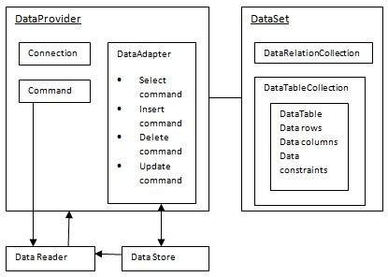
ADO.NET
ADO.NET provides a bridge between the front end controls and the back end database. The ADO.NET objects encapsulate all the data access operations and the controls interact with these objects to display data, thus hiding the details of movement of data.
The following figure shows the ADO.NET objects at a glance:

Slide 33
The Architecture of ADO.NET:
The ADO.NET Architecture is comprised of 6 important components. They are as follows:
Connection
Command
DataReader
DataAdapter
DataSet
DataView
From the above components, two components are compulsory. One is the command object and the other one is the connection object. Irrespective of the operations like Insert, Update, Delete and Select, the command and connection object you always need.

Slide 34
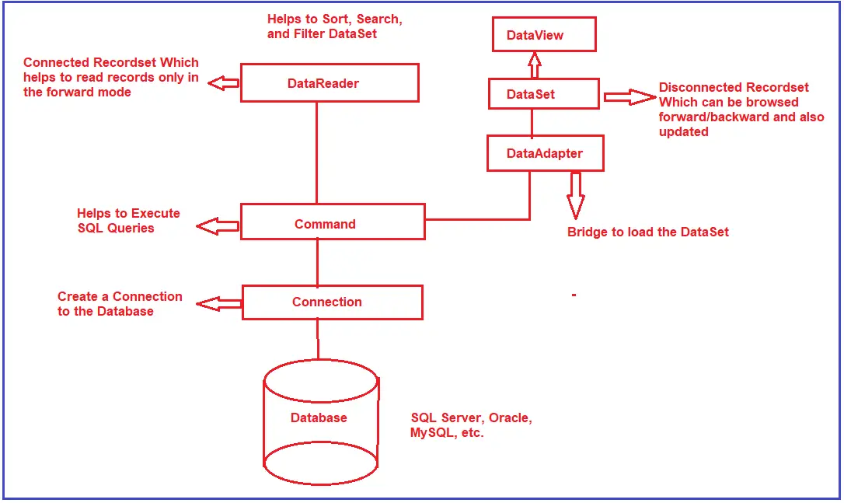

Slide 35
Connection: The connection object is the first important component of your application. It is required to connect to a backend database that may be SQL Server, Oracle, MySQL, etc. You must have two things to create a connection object. Your database Machine name or IP address or someplace where it is stored is where it is. The second thing is security credentials, such as whether it’s a Windows authentication or username and password-based authentication. The connection is created using the connection object and a backend data source must be connected to using the connection.
Command:
The Second important component of ADO.NET Architecture is the Command Object. When we talk about databases like SQL Server, Oracle, MySQL, etc., we know one thing, these databases only understand SQL. The Command Object is the component where you go and write your SQL queries. Later you take the command object and execute it over the connection. That means using the command object, you can fetch data or send data to the database i.e. performing the Database CRUD Operations.
Note: From the Command Object onwards, you can go in two different ways. One is you can go with the DataSet way and the other is, you can go with the DataReader way. Which way you need to choose, basically will depend on the situation.
Command:
The Second important component of ADO.NET Architecture is the Command Object. When we talk about databases like SQL Server, Oracle, MySQL, etc., we know one thing, these databases only understand SQL. The Command Object is the component where you go and write your SQL queries. Later you take the command object and execute it over the connection. That means using the command object, you can fetch data or send data to the database i.e. performing the Database CRUD Operations.
Note: From the Command Object onwards, you can go in two different ways. One is you can go with the DataSet way and the other is, you can go with the DataReader way. Which way you need to choose, basically will depend on the situation.
DataReader:
DataReader is a read-only connection-oriented recordset that helps us to read the records only in the forward mode. Here, you need to understand three things i.e. read-only, connection-oriented, and forward mode. Read-Only means using DataReader, we cannot Insert, Update, and Delete the data. Connection-Oriented means, it always requires an active and open connection to fetch the data. Forward mode means you can always read the next record, there is no way that you can read the previous record.

Slide 36
DataSet:
It is a Disconnected record set that can be browsed in both i.e. forward and backward mode. It is not read-only i.e. you can update the data present in the data set. Actually, DataSet is a collection of DataTables that holds the data and we can add, update, and delete data in a data table. The DataAdapter fills a DataSet using data.
DataAdapter:
The DataAdapter is one of the Components of ADO.NET which acts as a bridge between the command object and the dataset. What the DataAdapter does is, it takes the data from the command object and fills the data set.
DataView Class
The DataView class enables us to create different views of the data stored in a DataTable. This is most often used in data-binding applications. Using a DataView, we can expose the data in a table with different sort orders, and you can filter the data by row state or based on a filter expression.
ADO.NET namespaces
Namespaces Description
System.Data Contains the definition for columns, relations, tables, database, rows, views and constraints.
System.Data.SqlClient Contains the classes that are used to connect to a MS SQL server database such as SqlCommand, SqlConnection, and SqlDataAdapter.
System.Data.Odbc Contains classes required to connect to most ODBC drivers. These classes include OdbcCommand and OdbcConnection.
System.Data.OracleClient Contains classes such as OracleConnection and OracleCommand required to connect to an Oracle database.

Slide 37
Connection strings
You need to supply a connection string in the Connection class object. The connection string is a series of name/value settings separated by semicolons (;). A connection string contains information such as the location of the database, its name and its authentication mechanism.
How do you store the connection string in the configuration file?
As we are working with a console application, the configuration file is app.config. So, we need to store the connection string in the app.config file as shown below. Give a meaningful name to your connection string. As we will communicate with the SQL Server database, we need to provide the provider name as System.Data.SqlClient.
<connectionStrings>
<add name="ConnectionString"
connectionString="data source=.; database=student; integrated security=SSPI"
providerName="System.Data.SqlClient" />
</connectionStrings>
How to read the connection string from the app.config file?
In order to read the connection string from the configuration file, you need to use the ConnectionStrings property of the ConfigurationManager class. The ConfigurationManager class is present in System.Configuration namespace. By default, this System.Configuration DLL is not included in our application, so we need to add this DLL first.
Example to Read the Connection String from the Configuration File:
Please modify the Program.cs class file, as shown below, reads the connection string from the configuration file.

Slide 38
using System;
using System.Configuration;
using System.Data.SqlClient;
namespace AdoNetConsoleApplication
{
class Program
{
static void Main(string[] args)
{
try
{
string ConString = ConfigurationManager.ConnectionStrings["ConnectionString"].ConnectionString;
using (SqlConnection connection = new SqlConnection(ConString))
{
connection.Open();
Console.WriteLine("Connection Established Successfully");
}
}
catch (Exception e)
{
Console.WriteLine("OOPs, something went wrong.\n" + e);
}
Console.ReadKey();
}
}
}

Slide 39
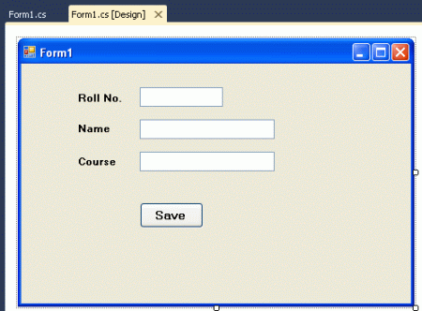
SqlCommand Method
ExecuteNonQuery() : The ExecuteNonQuery() method does not return any record. Which means we use ExecuteNonQuery() in all operations with databases except retrieving records from a database. It only returns the number of affected rows.
Now we use this method in our application. There is a database "student" and a database "student_detail" which has no record. I am giving a simple example to insert a record into database.
Take 3 labels, 3 textboxes and 1 button and arrange them as in the following figure.

Slide 40
using System;
using System.Collections.Generic;
using System.ComponentModel;
using System.Data;
using System.Drawing;
using System.Linq;
using System.Text;
using System.Windows.Forms;
using System.Data.SqlClient;
namespace sqlconnectionANDsqlcommand
{
public partial class Form1 : Form
{
public Form1()
{
InitializeComponent();
}
private void Form1_Load(object sender, EventArgs e)
{
}
private void btnclick_Click(object sender, EventArgs e)
{
// Creating instance of SqlConnection
SqlConnection conn = new SqlConnection("Database=student;Server=.;user=sa;password=aaaaaaa");
conn.Open();// open the database connection
SqlCommand cmd = new SqlCommand();// Creating instance of SqlCommand
cmd.Connection = conn; // set the connection to instance of SqlCommand
cmd.CommandText = "insert into student_detail values (" + txtrollno.Text + ",'" + txtname.Text + "','" + txtcourse.Text + "')"; // set
//the sql command ( Statement )
cmd.ExecuteNonQuery();
MessageBox.Show("Record Saved"); // showing messagebox for confirmation message for user
conn.Close();// Close the connection
}
}
}

Slide 41
ExecuteScalar() : The ExecuteScalar() returns a single value from the database. Generally, it is used with an aggregate function (a function which returns a single value).
Suppose there is a need to check how many records are in the database table. Then we use this function. Add another button to your application and set its text property to "Count" and write the following code on button click.
private void btncount_Click(object sender, EventArgs e)
{
SqlConnection conn = new SqlConnection("Database=student;Server=.;user=sa;password=aaaaaaa");
conn.Open();// open the database connection
SqlCommand cmd = new SqlCommand();// Creating instance of SqlCommand
cmd.Connection = conn; // set the connection to instance of SqlCommand
cmd.CommandText = "select count (*) from student_detail" ; // set the sql command ( Statement )
string record= cmd.ExecuteScalar().ToString();
MessageBox.Show("Total records : "+ record );
conn.Close();// Close the connection
}

Slide 42
Execute Reader:
Execute Reader is used with select statement that return rows from one or more table.

